Slide 1

00077
Fair and Efficient Allocation of EU Emission Allowances
DIMOS S. (1), FOTAKIS D. (1), MATHIOUDAKI A. (1) and PAPADOPOULOS K. (1)
1. School of Electrical and Computer Engineering, National Technical University of Athens, Iroon Polytechniou 9, 15780 Athens
Notes:
Hello,
I'm Kostas Papadopoulos, and I'm honored to stand before you today to present research on the fair and efficient allocation of Emission permits within the EU ETS System. This research is a collaborative effort involving Ph.D. student Sotiris Dimos, esteemed professor Dimitrios Fotakis, Ph.D. student Angeliki Mathioudaki, and myself.

Slide 2

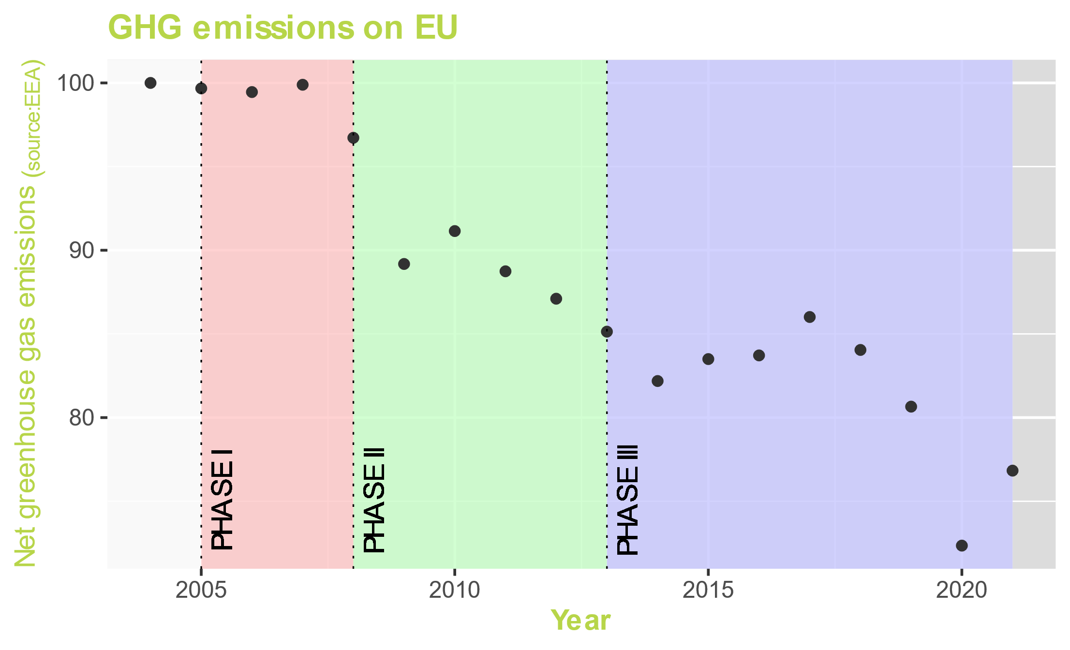
EU Emission Trading System (ETS)
Notes:
Before we dive into the details, let's understand the essence of the European Union Emissions Trading System, or EU ETS. This system employs a market-based approach to combat climate change by assigning a value to carbon emissions. It incentivizes companies to invest in green technologies and minimize their GHG emissions. Throughout its history, the EU ETS has evolved through different phases, each contributing to its effectiveness. At present, we find ourselves in the fourth phase, which is not depicted here.

Slide 3
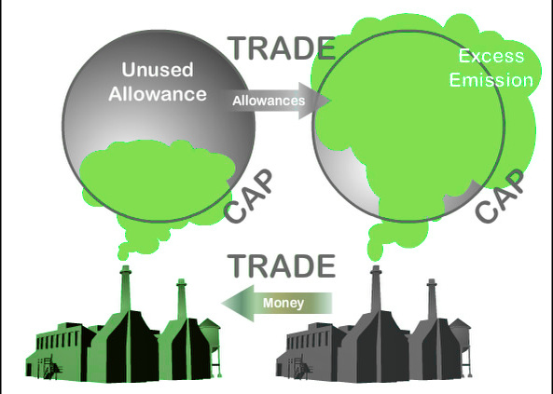
EU Emission Trading System (ETS)
Notes:
The EU ETS operates on the principle of "cap and trade." It begins by establishing a stringent cap, a maximum threshold, on the total volume of greenhouse gas emissions that will be generated by the members of it. For the first three phases, this cap has been progressively reduced by 1.74% compared to the preceding year. In the current fourth phase, it's even more ambitious, with a reduction of 2.2%.

Slide 4
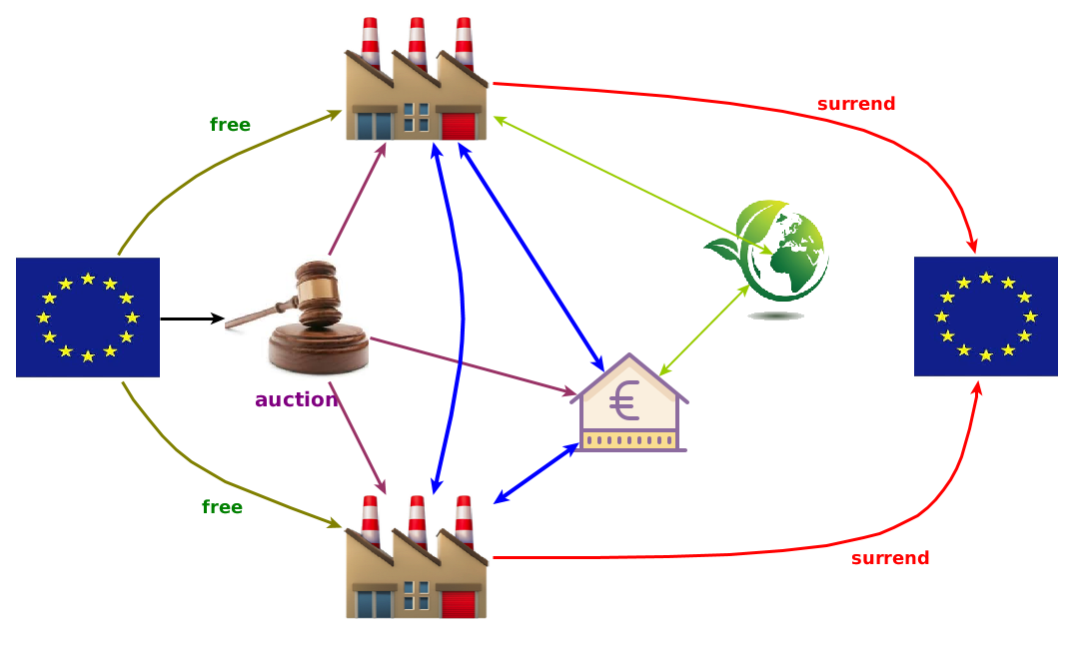
ETS Functionality
Notes:
Let's see that in more detail. Companies may purchase allowances through government auctions or on the carbon market. Throughout the year, companies continuously monitor their actual greenhouse gas emissions. Companies can freely trade their allowances on the carbon market. Companies that do not surrender enough allowances to cover their emissions at the end of the year face significant penalties.
Seems simple enough, yet, there may be challenges ahead.

Slide 5
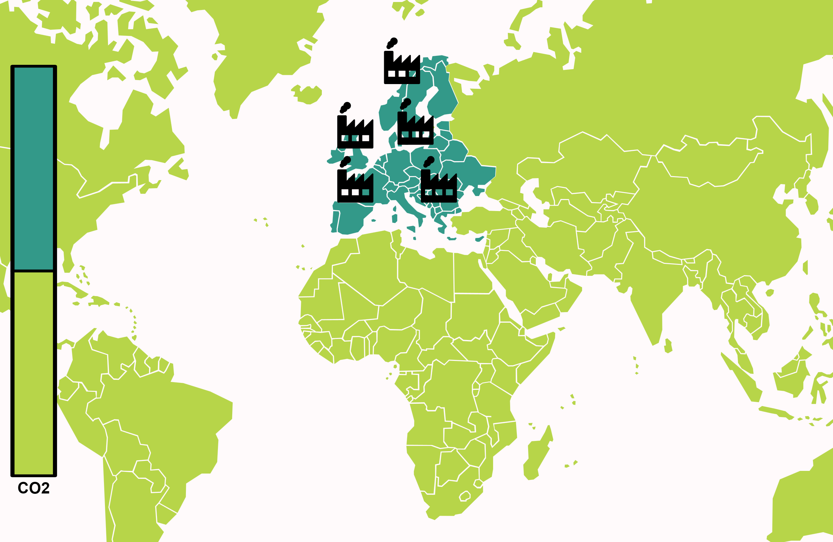
Carbon Leakage
Minimal σχέδιο που το περιγράφει
Notes:
This whole idea would work better in an isolated environment. But, once competitors appear, it gets more complicated. The primary issue at hand is carbon leakage. To illustrate this, consider the bar chart on the left, where we represent the total CO2 emissions. The teal portion represents emissions from EU ETS members, while the lime portion signifies emissions from non-members.

Slide 6
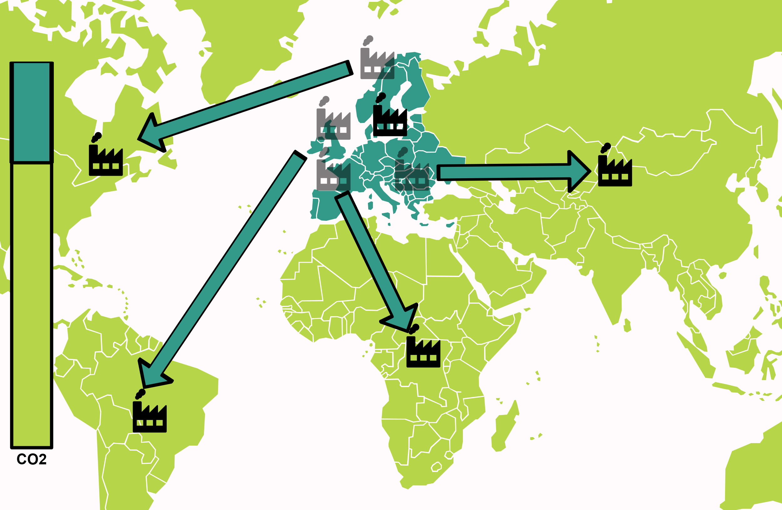
Carbon Leakage
Minimal σχέδιο που το περιγράφει
Notes:
An unfavorable scenario involves polluting companies relocating outside the emission trading system to evade allowance payments. In this scenario, there 3 major problems. 1) Overall CO2 emissions remain unaffected. 2) It is an economic disaster for members of the ETS 3) if it happens in a large scale, then the cap is rendered useless.

Slide 7
ETS Functionality
Notes:
To address this challenge, the EU ETS incorporates an additional measure: the allocation of free allowances at the beginning of each year. During the initial two phases, allowances were primarily allocated through grandfathering methods. However, starting in the third phase, a benchmark-based approach was introduced. These benchmarks are derived from the average performance of the 10% most efficient installations within a subsector in the European Union. This approach is particularly advantageous because it reduces the likelihood of companies exiting to evade carbon fees while avoiding subsidizing sectors like energy production where such exits are improbable due to increased costs.

Slide 8
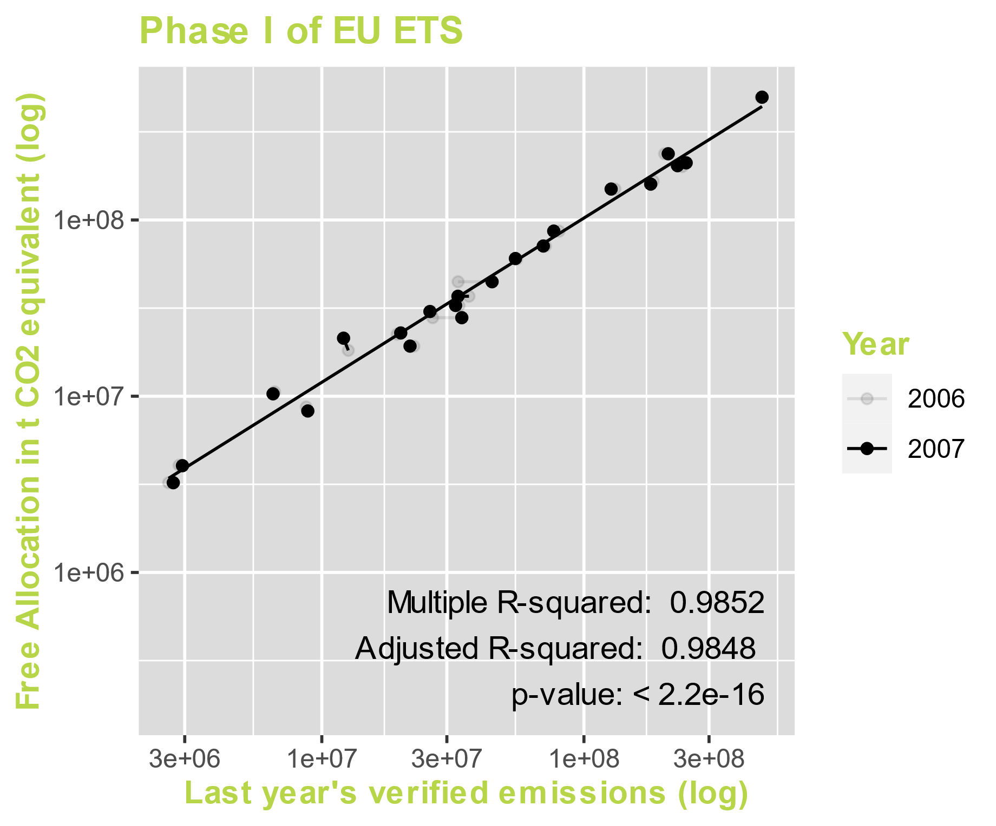
Allocation of
Free Allowances
Sectors vs Countries
Phase I
2005-2007
Notes:
Now, let's shift our focus because while this approach promotes fairness among companies within the same sector, we must also consider its impact on other stakeholders like different sectors, countries, workers, the environment, or citizens. In this study, our primary focus will be on the member countries of the EU ETS. In the graph presented, each data point represents an individual country at a specific year. On the x-axis, we have the total verified emissions from companies within each country for the previous year, while the y-axis illustrates the cumulative free allowances allocated to companies in each respective country. As you can observe, there exists a strong correlation between these two variables. This correlation is particularly evident in this graph, which represents the first phase of the program, characterized by predominantly grandfathering-based allocation.

Slide 9
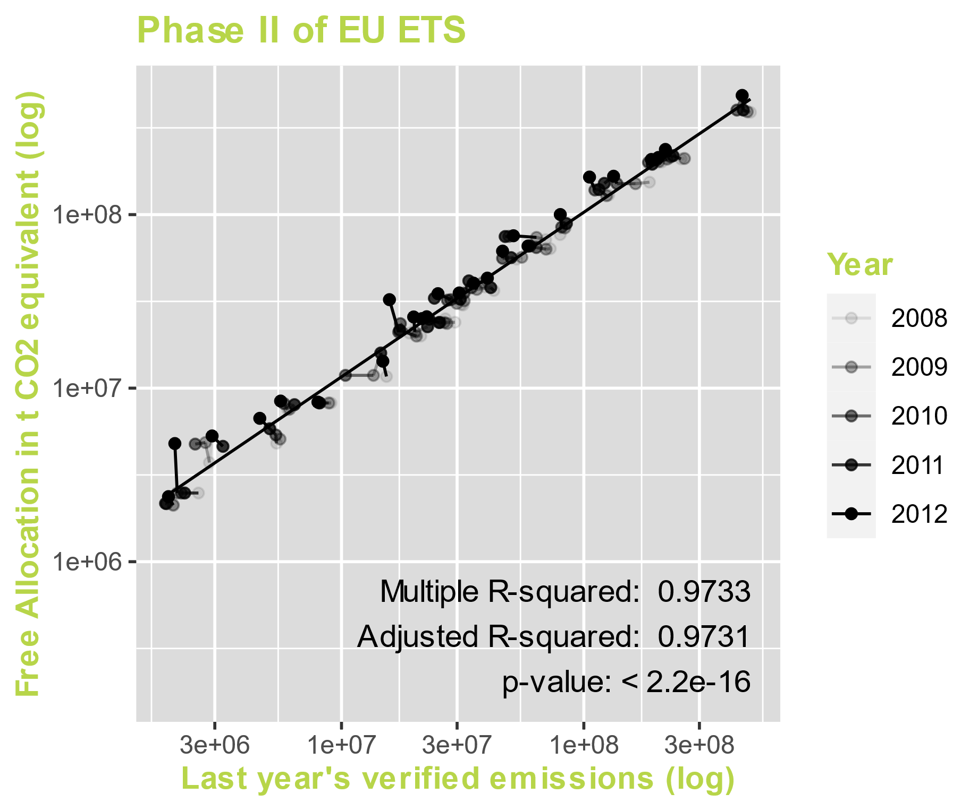
Allocation of
Free Allowances
Sectors vs Countries
Phase II
2008-2012
Notes:
"In the second phase of the EU ETS, a remarkably similar pattern emerges. Free allocation continues to rely primarily on the grandfathering method for permit allocation.

Slide 10
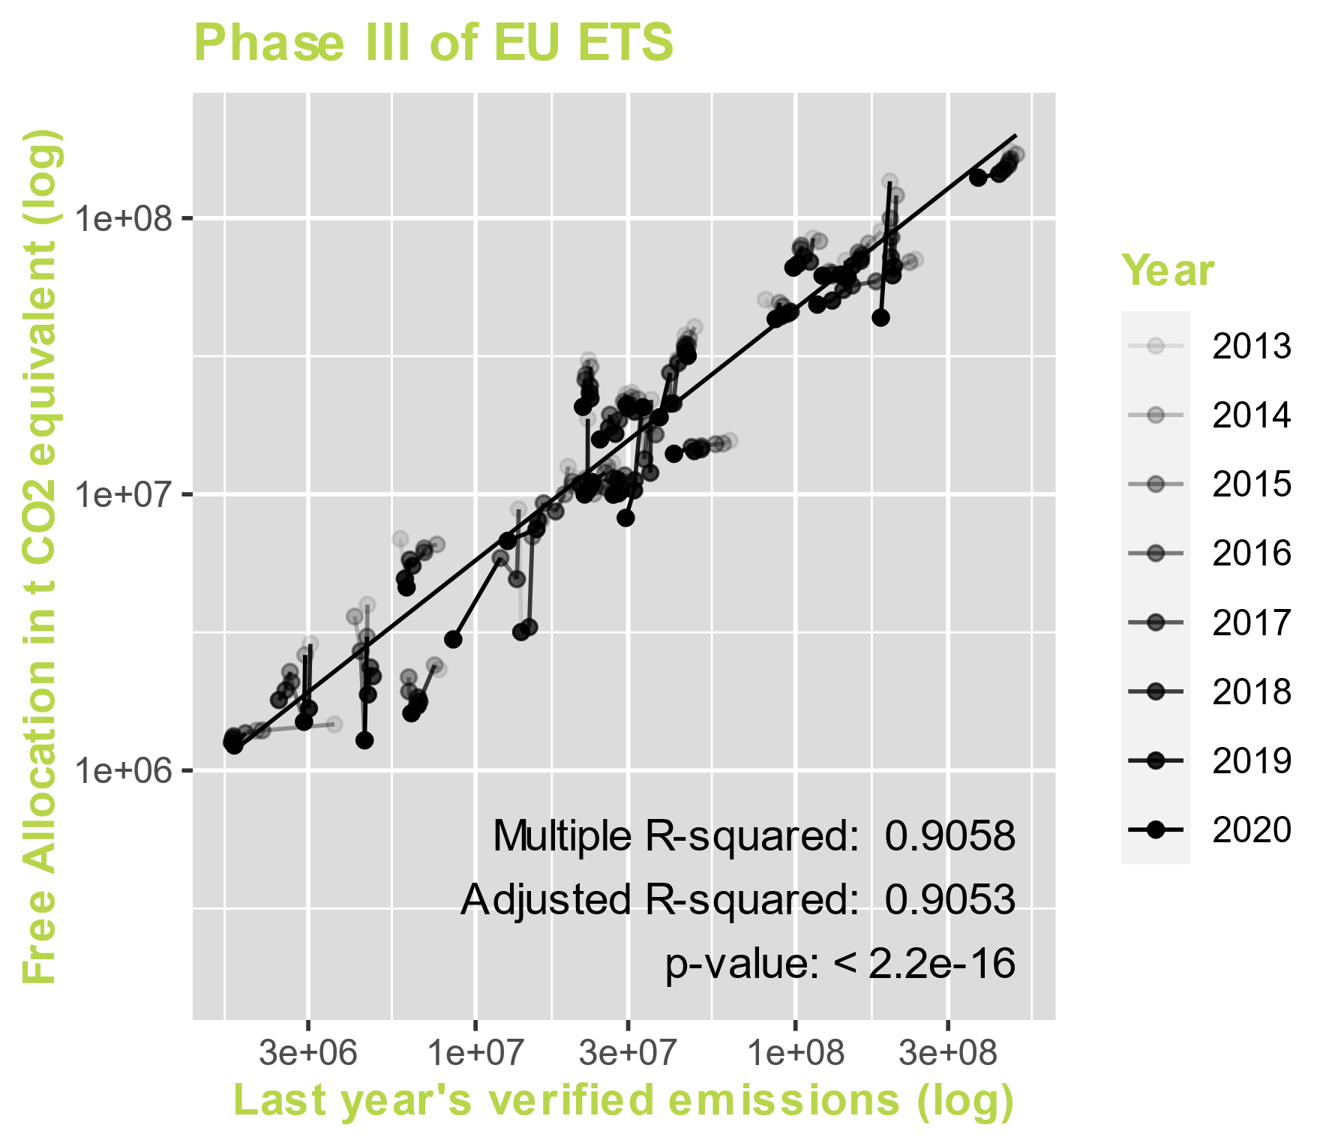
Allocation of
Free Allowances
Sectors vs Countries
Phase III
2013-2020
Notes:
The third phase of the EU ETS introduces a subtle shift in the dynamics. While we still observe a correlation between emissions and free allowances, this correlation is less pronounced. This shift can be directly attributed to the benchmark-based allocation method. Under this new approach, companies with a lower risk of carbon leakage receive relatively fewer allowances.

Slide 11
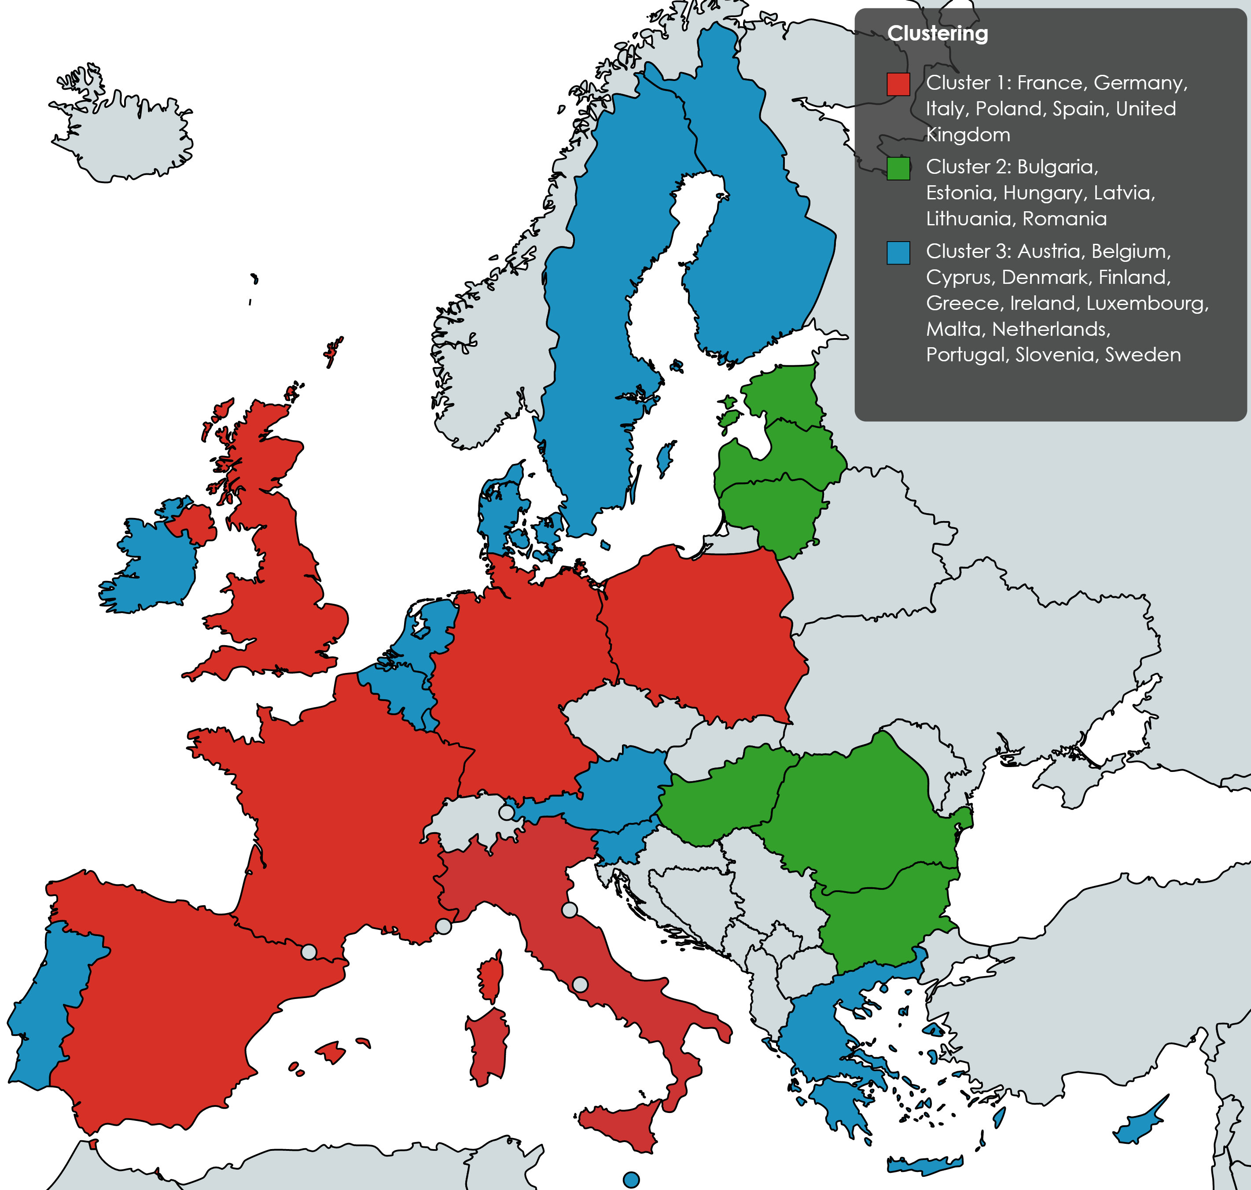
Indicators for clustering
Indicators | Principle | Data Source
Population | Fairness | https://data.worldbank.org/indicator/SP.POP.TOTL
GDP per capita | Fairness | https://data.worldbank.org/indicator/NY.GDP.PCAP.CD
Inflation | Fairness | https://data.worldbank.org/indicator/FP.CPI.TOTL.ZG
Agriculture | Fairness | http://wdi.worldbank.org/table/4.2#
Industry | Fairness | http://wdi.worldbank.org/table/4.2#
Manufacturing | Fairness | http://wdi.worldbank.org/table/4.2#
Total Energy Supply | Fairness | https://ec.europa.eu/eurostat/databrowser/view/nrg_bal_s/
Energy Intensity | Econ. Efficiency | https://ec.europa.eu/eurostat/databrowser/view/NRG_IND_EI
Verified Emissions | Fairness | https://www.eea.europa.eu/data-and-maps/dashboards/emissions-trading-viewer-1
Free Allocated Emissions | - | https://www.eea.europa.eu/data-and-maps/dashboards/emissions-trading-viewer-1
Notes:
In our effort to characterize countries within the EU ETS in terms of size, economic conditions, and energy consumption, we adopted an indicator-based approach. We carefully selected indicators that align with the two primary allocation principles of 'Fairness' and 'Economic Efficiency.' In order to enhance the fairness principle further, we incorporated an indicator related to inflation, as it reflects purchasing power.
To provide a more comprehensive analysis, we also included data on the Nominal GDP and sector composition for all EU Member States. This inclusion allows for a more nuanced assessment of both vertical equity and the ability to pay criteria. The table provided lists the selected indicators alongside their corresponding allocation principles.
We employed these indicators to conduct a comprehensive cluster analysis. After careful consideration and the application of predefined benchmarks, we determined that a three-cluster classification yielded the most optimal results. Here, you can observe the composition of these clusters:
Cluster 1 encompasses some of the largest European countries, including Germany, France, Spain, and Italy, among others.
The second cluster is comprised mainly of Eastern European countries.
Lastly, the third cluster encompasses the remaining countries within the EU ETS.

Slide 12
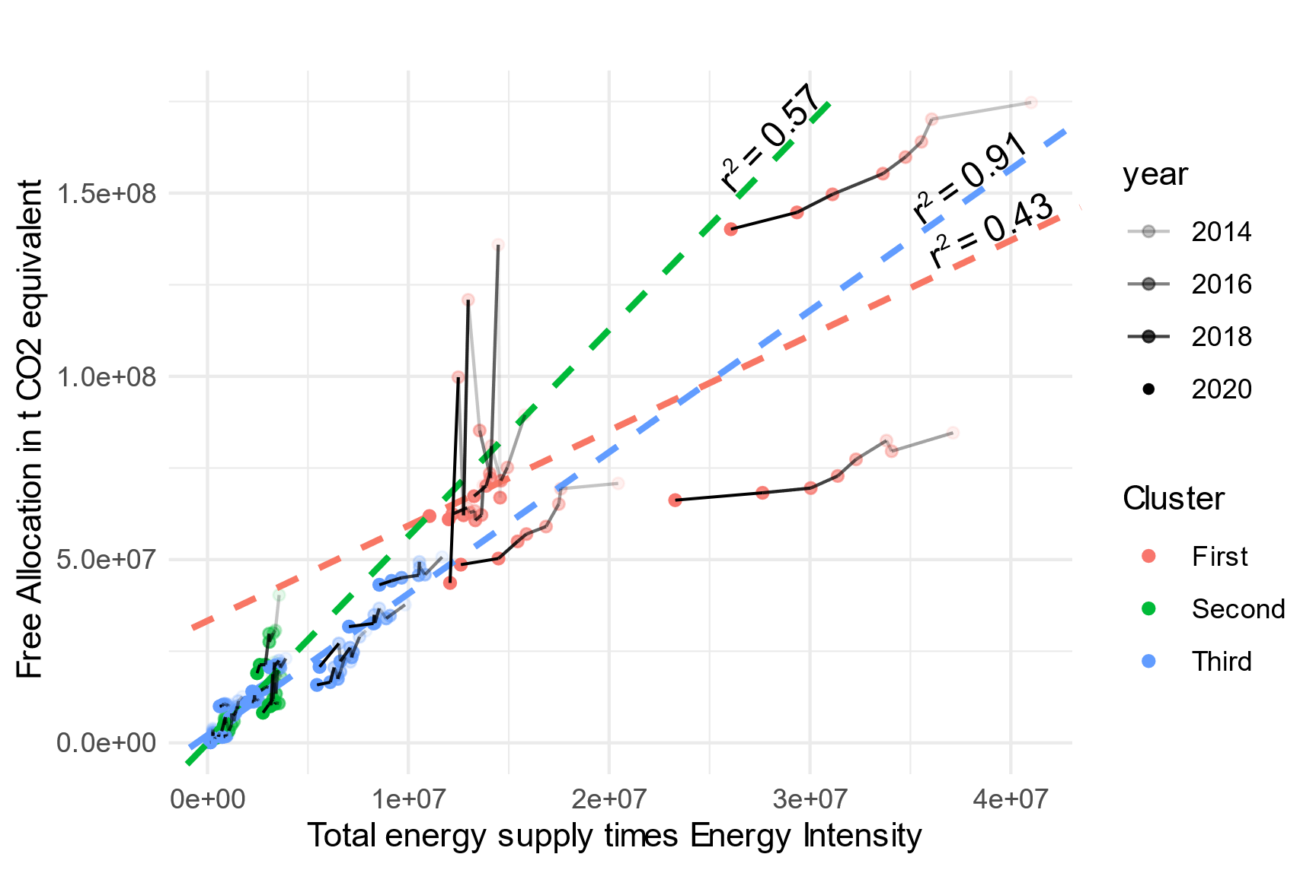
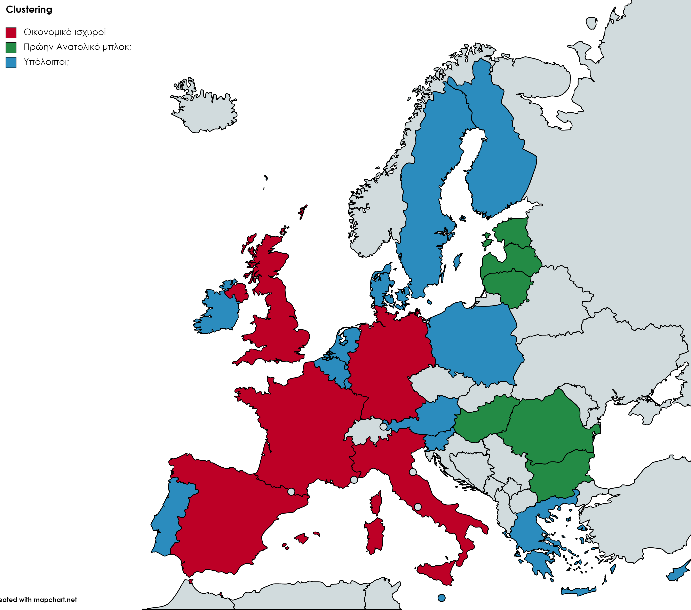
Intel through clustering
Notes:
For this specific graph, the x-axis represents a composite indicator: the total energy supply multiplied by energy intensity. Energy intensity quantifies the energy required to produce one unit of Gross Domestic Product (GDP) or economic output, making it a valuable metric for assessing energy efficiency and its environmental impact. This composite indicator provides insights into the energy needed to support economic development.
Our observations reveal that this indicator appears to correlate with free allocation within the third cluster but does not exhibit a similar relationship in the other clusters. Furthermore, it's noteworthy that a majority of countries across clusters appear to be reducing this indicator. This implies that countries are either decreasing their energy requirements, enhancing their efficiency, or implementing a combination of both strategies.

Slide 13
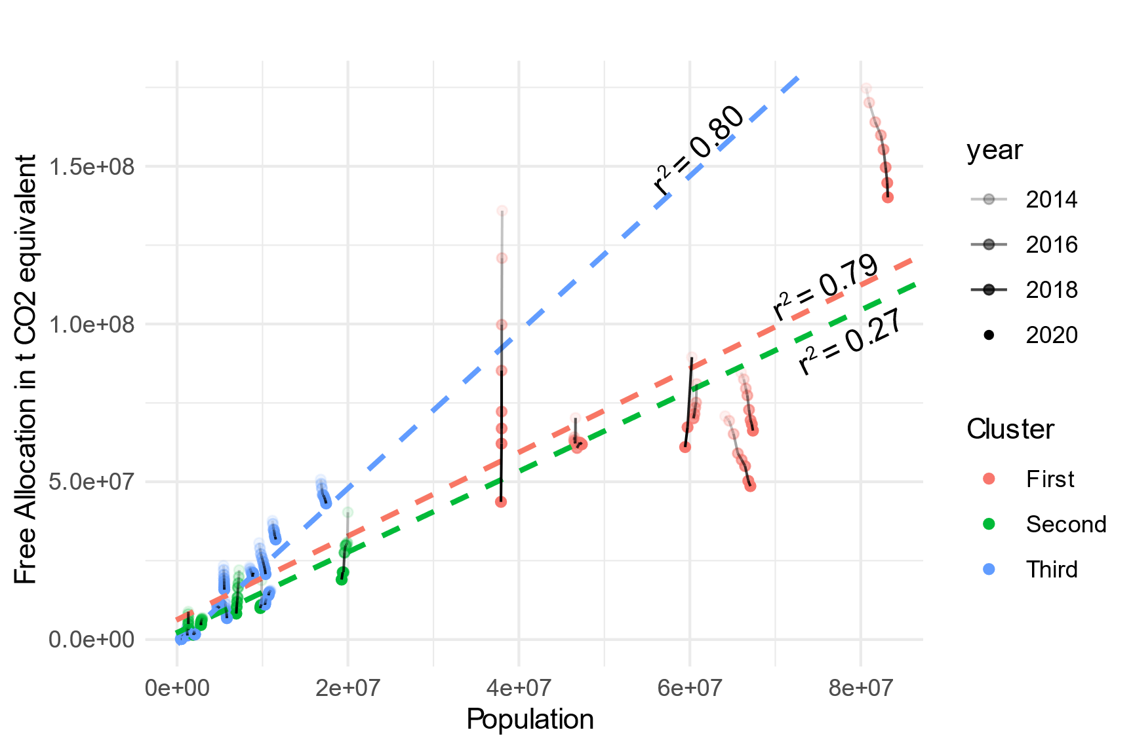
Intel through clustering
Notes:
Shifting our focus to another crucial indicator, namely population, we observe a correlation with free allocation in most countries, with one notable exception being Eastern Europe.

Slide 14
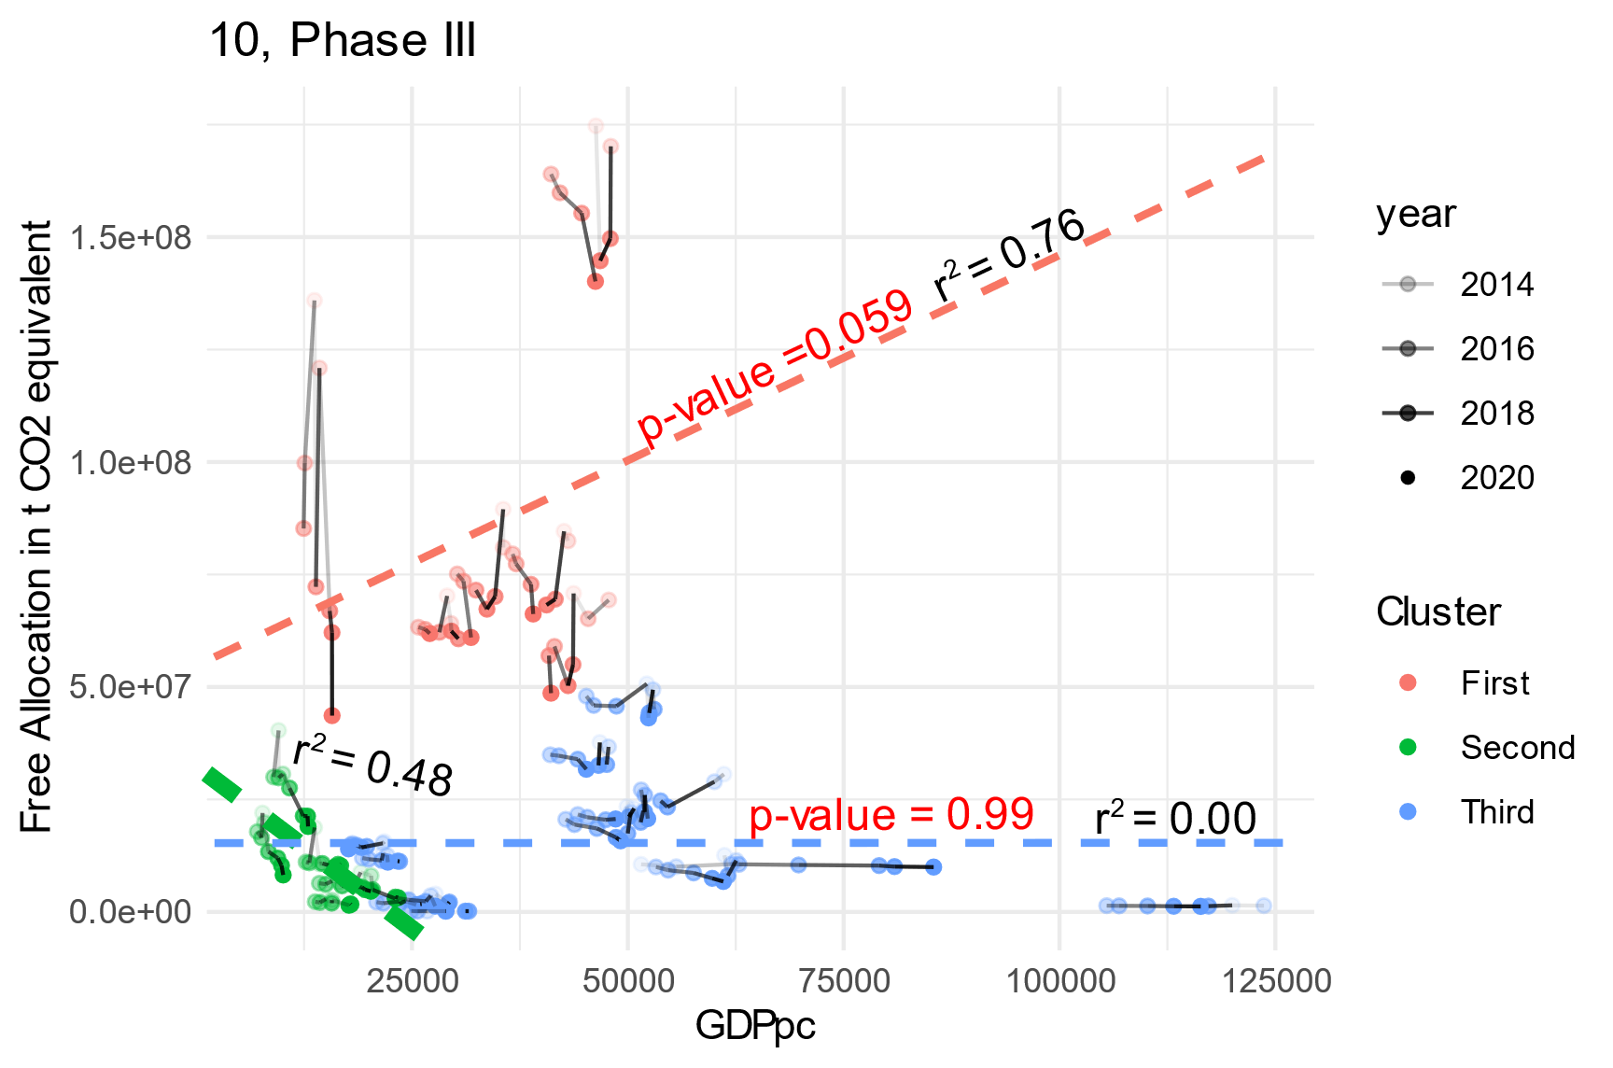
Intel through clustering
Notes:
Presenting GDP per capita solely for illustrative purposes, we highlight an indicator that demonstrates no explanatory power.

Slide 15
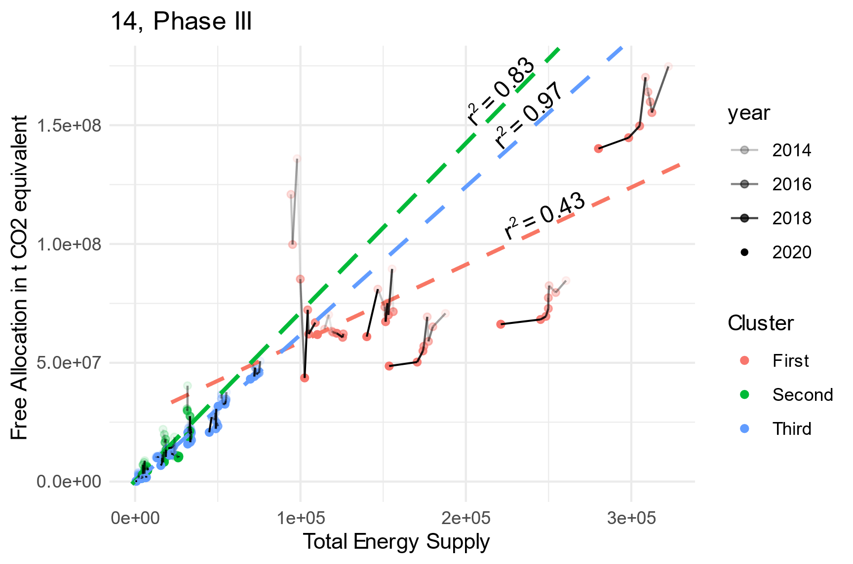
Intel through clustering
Notes:
Finally, total energy supply seems to be excellent in explaining the free allocation for the smaller countries, while failing for the others.

Slide 16

Suggestion of simple LP
$$max\sum_{i}{\sum_{j}{v_{ij}\frac{{GDP}_{ij}}{e_{ij}}{GDP}_{i}^{pps}}}$$
Core Constrains:
$$\sum_{i}{\sum_{j}{v_{ij}=1}}$$
$$\sum_{j}{v_{ij}=v_{i} } and\sum_{i}{v_{ij}=v_{j} }$$
Extra Constrains:
$$a_{1}v_{j}^{′}≤\sum_{i}{v_{ij}≤a_{2}v_{j}^{′}} , where a_{1}=\min\left\{0.8, \frac{\overline{{GDP}^{pps}}}{{GDP}_{i}^{pps}}\right\}$$
Notes:
Last, but certainly not least, we introduce an optimization problem designed to facilitate the comparison of various allocation methods. This versatile linear problem can accommodate a wide array of constraints, allowing us to integrate both efficiency and fairness principles.
In our problem formulation, indices 'i' represent different countries, and 'j' represents sectors, enabling us to model diverse criteria. The objective function is defined as the product of the free allocation for a sector within a country, multiplied by the energy intensity of that sector within the same country, adjusted by a modifier to convert from euros to Purchase Power Standards.
This optimization problem for allowance allocation serves as a powerful tool to strike a balance between fairness and efficiency in our analysis.

Slide 17
Conclusion and future work
Main contribution:
Clusters differ in terms of free allocation, as their amount of freely distributed permits depends on different indicators.
Provide a simple and flexible allowance allocation problem that can incorporate various fair and efficient criteria from the literature as constraints
Future work:
Incorporate new data
Investigate the behavior of different clusters.
Experiment with different constrains on the LP shown
Notes:
This study makes a valuable contribution to the ongoing discourse surrounding the enhancement of EU ETS allowance allocation, addressing both country-specific and sector-specific perspectives.

Slide 18
Thank you for your attention!
Papadopoulos Kostas
kostasalexpapadopoulos@gmail.com
Corresponding Author:
Dimos Sotirios, sdimos@corelab.ntua.gr
Notes:
Looking ahead, our future endeavors will involve the integration of updated data, a deeper investigation into the behavior of diverse countries, and the quest for further valuable insights. We also plan to explore and experiment more extensively with the linear programming techniques presented earlier.
Thank you for your time!

